Slide 1
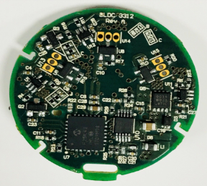
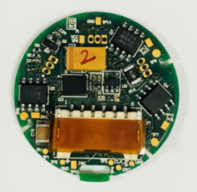
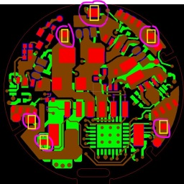
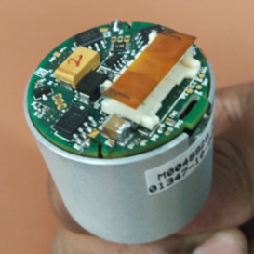
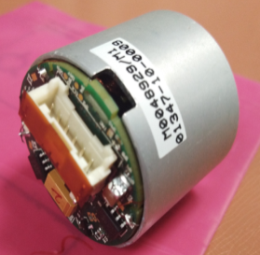
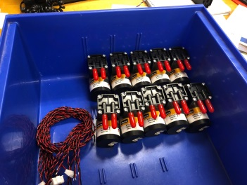
BLDC Motor Controller Board
Achievements:
Common Controller Hardware and Firmware Platform built for different Motor Models
Low cost microcontroller identified
The entire BoM cost was $5.8 for 10K Quantity
Second set of 50 prototypes built, tested and shipped to Parker
Parker Customer testing completed - Production is in progress
Detailed Documentation provided.
Product Requirements Specification (PRS)
Hardware Design Document (HDD)
Software Design Document (SDD)
Operating Manual
The board worked first pass for all the motor models and variants
Program | Design | Division | -
Project Schedule | 4 Months | Team Size | 3
Scope:
Design and Develop of a common Control board platform for 33mm and 28mm BLDC Motors. The control board shall work with different variants of 6V, 12V, 24V motors. The project scope included the following:
Hardware Design
Firmware Design
Prototyping, Testing
Tools/Techniques used:
Altium
MPLAB X
Gerber Viewer
Schematic Guidelines – Schematics and PCB Layout
Application : Medical Industry

